Slide 1
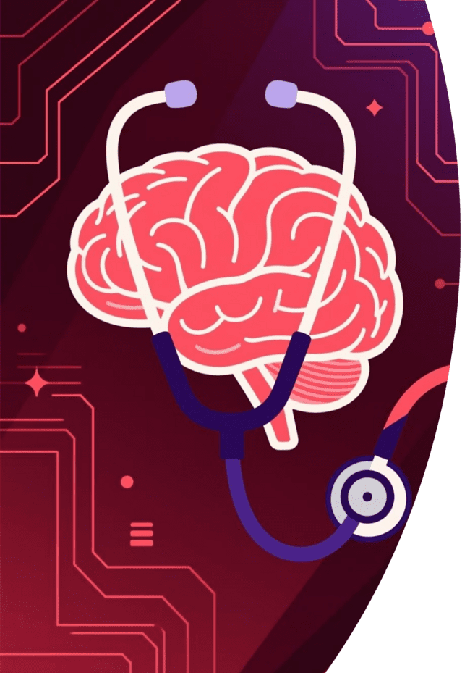
DOCTOR 2.0 – Working Model and Evaluation
A Multimodal Medical Chatbot (Vision + Voice)
Presented to: Prof. Arun Bhadwal
Team Members: Rachit Tayal, Kartik Tayal, Kartik Raika

Slide 2





Introducing AI Doctor 2.0: The Multimodal Assistant
AI Doctor 2.0 is an advanced AI assistant designed to simulate doctor–patient interactions by analyzing both voice and image inputs. This system integrates multiple open-source AI tools to provide end-to-end basic medical consultations.
Voice Input
Image Analysis
Real-time speech recognition for natural communication.
Multimodal vision capabilities for diagnostic support.
Voice Output
NLU Integration
Text-to-speech module for a human-like consultation response.
Natural Language Understanding processes input for medical context.

Slide 3




Core Objectives of the AI Doctor 2.0 Project
Our development focused on four critical areas to ensure a robust and functional prototype for healthcare applications.
Scalability
1
Building a modular prototype suitable for future expansion.
Accuracy & Speed
2
Ensuring fast, secure, and medically relevant analysis.
Real-Time Interaction
3
Enabling natural, continuous doctor–patient communication.
Multimodal Fusion
4
Combining vision, voice, and language understanding seamlessly.

Slide 4
Technology Stack and Key Tools
The project leverages state-of-the-art open-source and commercial APIs for efficient processing and accurate output generation.
Groq
OpenAI Whisper
High-speed AI inference and LLM execution acceleration.
Best-in-class model for accurate speech-to-text transcription.
Llama 3 Vision
gTTS / ElevenLabs
Multimodal LLM enabling visual and complex text reasoning.
Advanced text-to-speech engines for natural voice synthesis.
Gradio
Development
Quickly deploying an interactive, user-friendly interface.
Python and VS Code were the primary environment for development.

Slide 5
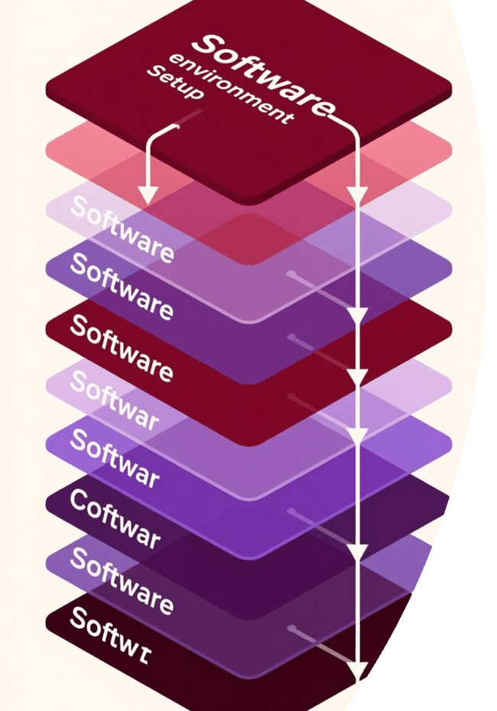
Project Infrastructure and Environment Setup
A crucial first step involved configuring the necessary dependencies and integrating modules into a unified environment for seamless operation.
Configuration
Dependencies, APIs, and environment tools set up and verified.
Audio Streaming
FFmpeg and PortAudio utilized for robust audio capture and processing.
Environment Management
Pipenv/venv/Conda used to isolate and manage project packages.
Interface Integration
All modules consolidated and connected within the Gradio user interface.

Slide 6

Phased Development Approach
The project was executed in four sequential phases, building up the necessary functionalities from core intelligence to final user interaction.
Brain of the Doctor
Setup and fine-tuning of the Multimodal LLM (Groq + Llama 3 Vision).
Voice of the Patient
Implementing robust Speech-to-Text conversion via OpenAI Whisper.
Voice of the Doctor
Integration of Text-to-Speech (gTTS/ElevenLabs) for verbal responses.
Gradio UI
Final integration, system testing, and user interface deployment.

Slide 7

Working Model Architecture: Process Flow
The end-to-end consultation process demonstrates how multimodal inputs are transformed into diagnostic suggestions and verbal responses in real-time.
Capture Audio
Speech-to-Text
Interpret Input
Synthesize Voice
Core Mechanism
The system operates under a tight latency constraint, leveraging Groq's acceleration to ensure the conversation remains fluid and responsive, simulating a natural human exchange.

Slide 8

Evaluation Methodology and Testing Framework
AI Doctor 2.0 was rigorously tested across 50 simulated consultation sessions to validate functional performance and conversational quality.
Transcription Accuracy
Measures the fidelity of Whisper's speech-to-text conversion.
Response Relevance
Evaluates the medical appropriateness and contextual understanding of Llama 3's output.
Latency (Speed)
Measures the time delay between patient input and doctor response (real-time performance).
Speech Quality (MOS Score)
A Mean Opinion Score rating of the naturalness and clarity of the Text-to-Speech output.

Slide 9

Performance Metrics Overview
The prototype successfully met or nearly met all predefined performance goals, demonstrating high reliability and responsiveness.
Transcription Accuracy
93.8%
95% target
Response Relevance
89.2%
90% target
Average Latency
1.4 sec
<2 sec goal
Speech Quality (MOS)
4.3/5
4.5/5 goal
Key Observations
The integration of Whisper and Groq significantly optimized the system for low latency, achieving a real-time response that is critical for clinical applications. The system demonstrates near-human conversational quality with high functional integration.

Slide 10
Key Results
AI Doctor 2.0 achieved significant milestones, delivering a robust and highly functional prototype ready for advanced applications.
Conversational Quality
Achieved near-human conversational fluidity, enhancing patient engagement and natural interaction.
Multimodal Functionality
Seamlessly integrated voice and image processing for comprehensive diagnostic support.
Modular Architecture
Designed for easy future upgrades and scalability, adapting to evolving medical knowledge and technology.

Slide 11
Challenges Faced
Throughout the development of AI Doctor 2.0, several key challenges emerged, requiring innovative solutions and careful resource management.
GPU Resource Management
API Integration Stability
Domain Data Scarcity
Achieving seamless and robust interaction across various third-party APIs presented significant integration challenges.
The absence of comprehensive, medically-specific datasets hindered advanced fine-tuning for nuanced diagnostic capabilities.
Optimising real-time audio processing proved complex due to limited GPU resources, necessitating efficient buffer handling.

Slide 12

Conclusion
AI Doctor 2.0 significantly enhances accessibility in telemedicine, delivering accurate, real-time, and human-like consultations.
This project establishes a foundational model for intelligent healthcare systems, showcasing the power of multimodal AI in clinical applications and paving the way for future advancements in patient care.

